Slide 1
KV6002 Week 6 – Assignment 2 Briefing and Expectations
Dr Rebecca Nicholson

Slide 2

KV6002 Team Project and Professionalism – Week 1
Today I will:
1. Give an assignment 2 briefing
2. Make clear our expectations

Slide 3
What am I being asked to submit?
Assignment 2 – Due 26th March 23:59
[Nb - If you got an extension for assignment 1 then check with your supervisor about what this means for assignment 2.]
We expect you to hand in:
1. A zipped file for your group project work submitted one per group
2. An evidence file for your project submitted individually

Slide 4
1. The Zipped File
A zipped file containing:
Video of your demonstration
All the files of the system
Sufficient installation instructions to enable re-installation of your product
A readme document with relevant system details (username / passwords etc. NOT for the hosting system.
The URL for the GitHub repository for the project (unless expressly agreed with your supervisor).
THIS IS SUBMITTED AS ONE FILE FOR YOUR WHOLE GROUP

Slide 5
2. The Evidence File
An evidence file with:
Your feedback from the stakeholder on the system
Your log of evidence to support peer assessment
THIS IS SUBMITTED INDIVIDUALLY

Slide 6

Deadlines
March 26th 23:59
Submit all files to Blackboard.
W/c 17th April 2023
Viva with Supervisor in usual supervision slot.

Slide 7

Assessments
Implementation of individual specified subsystem (20 individual marks)
Quality and Robustness of Subsystem (20 individual marks)
Feedback from stakeholders (20 individual marks)
Demonstration structure, understanding & responses to questions (20 individual marks)
Quality and Consistency of System Integration (20 group marks)

Slide 8
Assignment 1 Expectations
You demonstrate your system showing that:
It functions,
It meets the necessary requirements as set out by your client,
It is a robust system,
It is well integrated.
You provide separately some feedback from your client.

Slide 9
Implementation of individual specified subsystem (20 individual marks)
We are marking:
The comprehensiveness of implementation of the prototyped functions of your subsystem as specified in the terms of reference, including any enhancements based on feedback received.
What you can do:
Make sure that you demonstrate you have met all the requirements of your subsystem.

Slide 10
Implementation of individual specified subsystem (20 individual marks)
What a good demo of a subsystem might look like:
A comprehensive walkthrough of all the functionalities of your subsystem
A well ordered and planned ‘journey’ through the subsystem
Clearly explained user interactions
Where you addressed given feedback from your presentation

Slide 11
What do you mean ‘journey’?
Consider what functionalities you need to demo
Think about a sensible order to demo these
Try and piece this together in a way that makes sense
Do you want to go through in the order of the requirements?
Do you want to go through as if you are using the system?
Do you want to demonstrate the most important functionalities first, then the more intricate things second?

Slide 12
Quality and Robustness of Subsystem (20 individual marks)
What we are marking:
Error handling, user validation and robustness of subsystem functions; this should be demonstrated across the scope of the individual subsystem. To obtain full marks you must have provided a fluent implementation of the full scope of your subsystem. This includes appropriate handling of related non-functional requirements for example security and Human Computer Interaction related issues.
What you can do:
Ensure that you have tested, tested, tested. Demonstrate that you have appropriate error handling included in your system.
This should include more than simply ‘uh oh something went wrong’…

Slide 13
Quality and Robustness of Subsystem (20 individual marks)
What this might look like in practice:
If there are known errors these are handled.
Remember this can be both error codes / details AND user instructions / checks.
Provide some way of the user recovering from errors.
Ensure you have tested for and fixed fatal errors

Slide 14
Demonstration structure, understanding & responses to questions (20 individual marks)
What we are marking:
Structure and clarity of demonstration of your subsystem; understanding of the work done; quality of responses to questions about the prototype. We expect you to demonstrate professionalism by being punctual, using appropriate language and respect for your audience and team members and measured responses to questions. We hope it goes without saying but the demonstration of your subsystem should not disrupt another group member’s demonstration.
What you can do:
Ensure that you have thought through the structure of the demo
Ensure you understand how everything works (fine to use frameworks - this is encouraged BUT make sure you know how everything works).

Slide 15
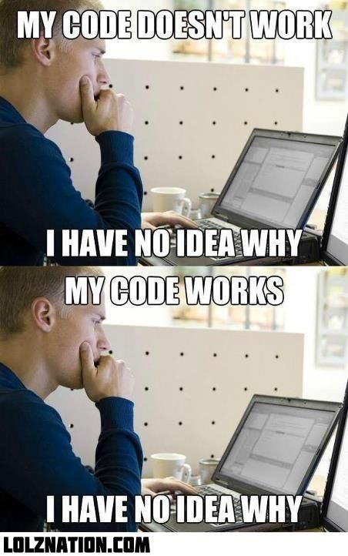
Demonstration structure, understanding & responses to questions (20 individual marks)
What this might look like in practice:
Think through and plan that ‘journey’ for your demo.
Ensure you know what each function does (even at a high level)
If you’re not sure how something functions then DON’T USE IT
The level we are looking for is ‘this uses the writeUserData function from Firebase to update the data held in the realtime database we’re using’.
It would be good to know what parameters you include as this might relate to questions about data security etc. but I don’t need to know what the function does beyond this.

Slide 16
Quality and Consistency of System Integration (20 group marks)
What we are marking:
Comprehensiveness of system integration and consistency of the whole system. You will not be penalised for incomplete individual sub-components (providing meaningful attempts have been made). Additionally, if there are group issues, please inform the module team at the earliest opportunity. These marks will be peer assessed.
What you can do:
Ensure that you have a plan for integration
Demonstrate how your system integrates
Demonstrate where and how the consistency is

Slide 17
Quality and Consistency of System Integration (20 group marks)
What this might look like in practice:
Make clear in your demo which are the consistent aspects across all the subsystems
If there are issues with integration explain what you were aiming for and where the issues are
Make clear how you tested the integration and how you ensured that your subsystem aligned with the group plan.

Slide 18
Feedback from stakeholders (20 individual marks)
What we are marking:
Clear explanation of the processes used to obtain this feedback, a concise summary of the feedback itself and have the feedback in the appendix.
Nb - 10 Marks for processes used. 10 Marks for the judgment of your stakeholders. However, the mark available for the judgement of your stakeholders is capped at the marks you receive for your processes ( So not many marks for “ Fred said it was great…….”).
What you can do:
Create a clear plan for how you will get feedback from your client.
Plan how best to write that up to make clear the feedback received.

Slide 19
Feedback from stakeholders (20 individual marks)
What we are marking:
Clear explanation of the processes used to obtain this feedback, a concise summary of the feedback itself and have the feedback in the appendix.
Nb - 10 Marks for processes used. 10 Marks for the judgment of your stakeholders. However, the mark available for the judgement of your stakeholders is capped at the marks you receive for your processes ( So not many marks for “ Fred said it was great…….”).
What you can do:
Create a clear plan for how you will get feedback from your client.
Plan how best to write that up to make clear the feedback received.

Slide 20
Tools for Video Recording
Panopto
Zoom
OBS

Slide 21
What tool should I use?
TOP TIP
I STRONGLY advise you to use Panopto for this.

Slide 22
Panopto
How to guide on Blackboard …
Will allow you to:
Record in the browser
Record a screen / source
Make some basic edits to your video

Slide 23
Week 6 expectations.
As a minimum you need to have:
Completed your planned tasks this week
Updated your log
Updated you task completion monitoring
Agreed a way of recording your demo

